Slide 1


Slide 2
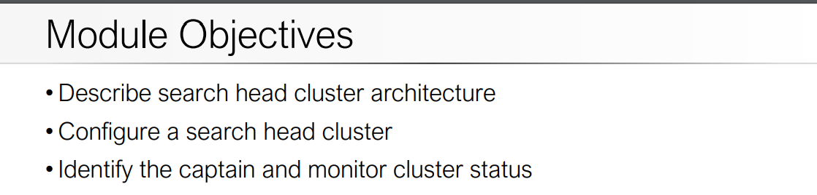

Slide 3
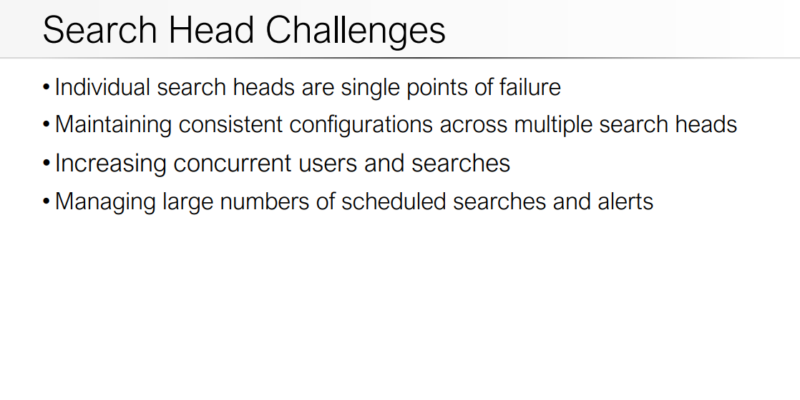

Slide 5
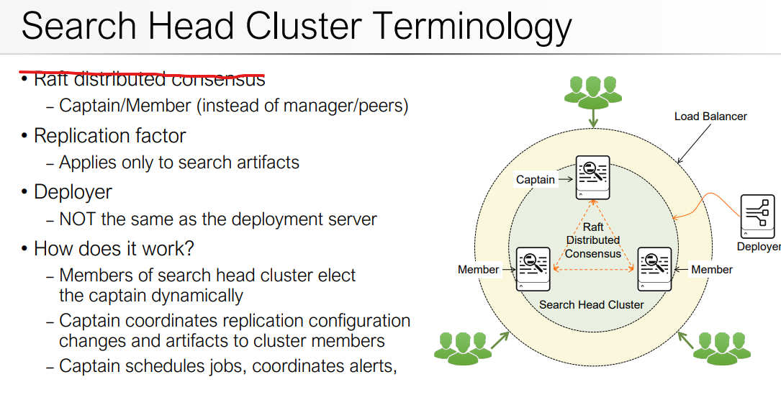

Slide 6
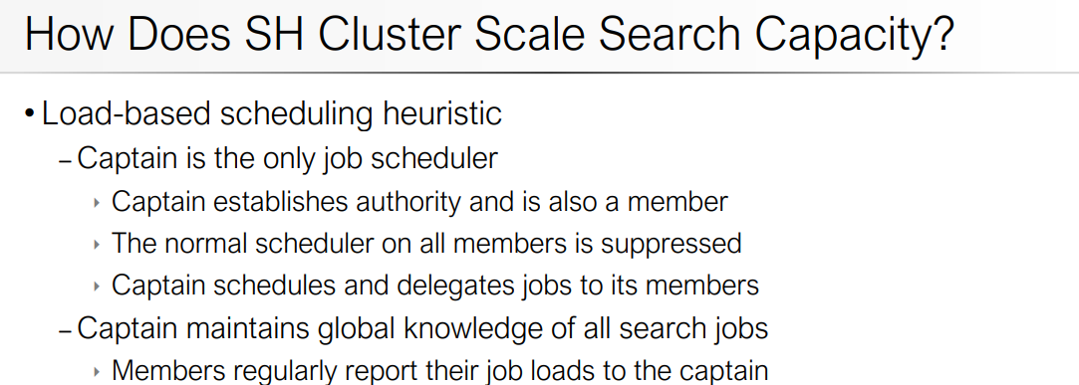

Slide 7
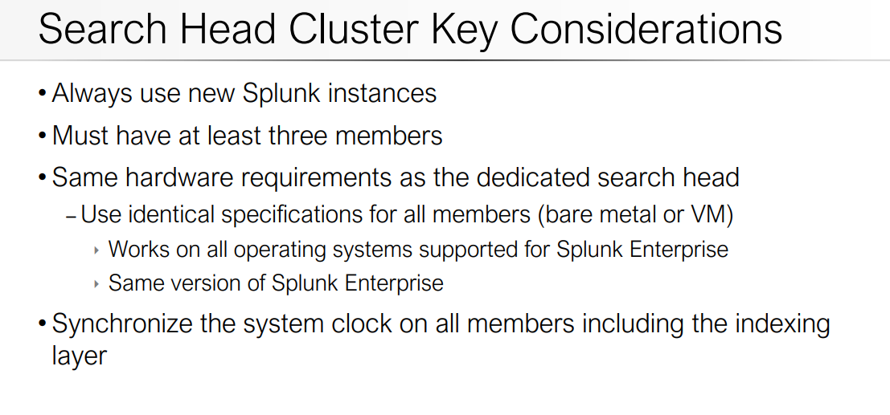

Slide 8
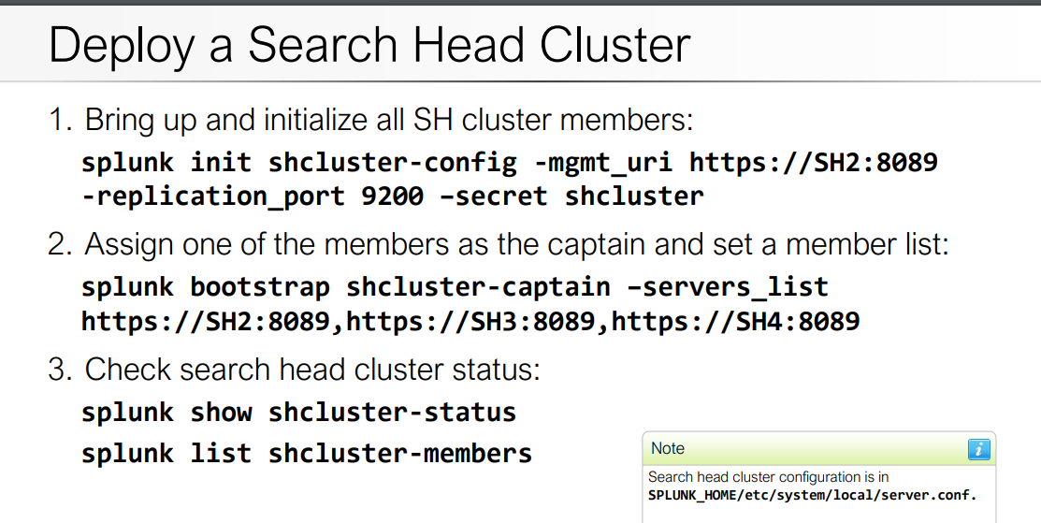

Slide 9
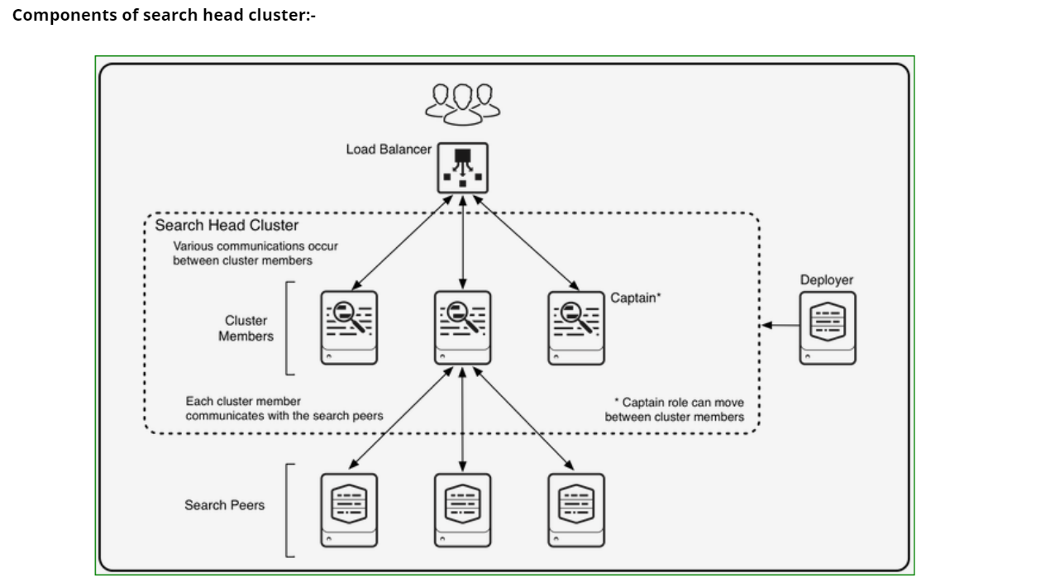

Slide 10
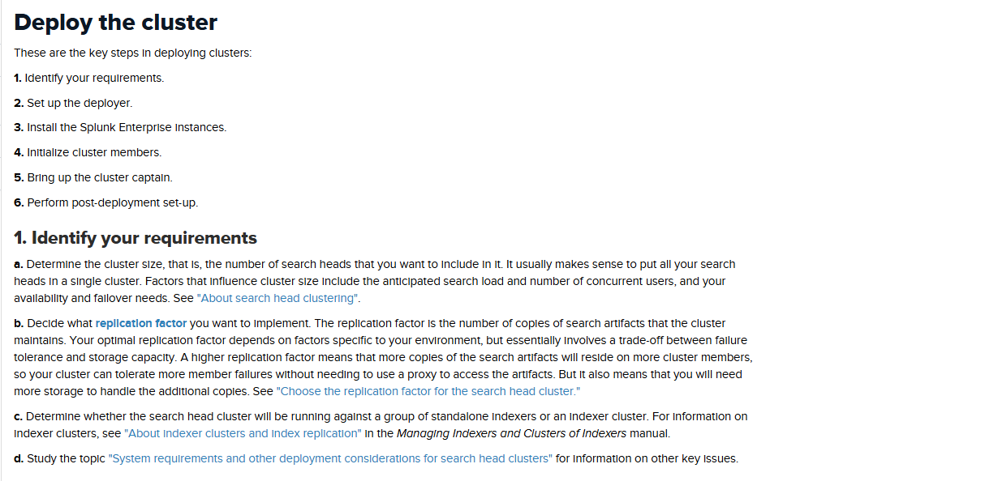

Slide 11
The deployer –This is a Splunk Enterprise instance that distributes apps and other configurations to the cluster members. It stands outside the cluster and cannot run on the same instance as a cluster member. It can, however, under some circumstances, reside on the same instance as other Splunk Enterprise components, such as a deployment server or an indexer cluster master/manager node

Slide 12
Search peers – These are the indexers that cluster members run their searches across. The search peers can be either independent indexers or nodes in an indexer cluster. Load balancer – This is third-party software or hardware optionally residing between the users and the cluster members. With a load balancer in place, users can access the set of search heads through a single interface, without needing to specify a particular one.

Slide 13
Implement search head cluster Determine cluster size 1. Make sure all insatance to be included in cluster should 2. have same OS and version. 3. Install splunk package to all instances. 4. Determine replication factor and port. 5. Determine cluster will work along standalone indexer / or 6. indexer cluster. Requirements – 1) Deployer 2) Search Head Instances……(Sh-instance1, SH-instance2, SH-instance3)

Slide 14
IMPORTANT : replication_factor – It states that how many SH replication copies we need if we have 3 Sh instances and want to replicate 3 copies then -replication_factor is 3 if more instances then we can set more replication factor replication_port – we can define any port lets keep 8080 mgmt_uri – Own instance host ip address conf_deploy_fetch_url – Deployer host ip address 1) To initialize Deployer in Deployer Instance edit server.conf file and set configurations.

Slide 15
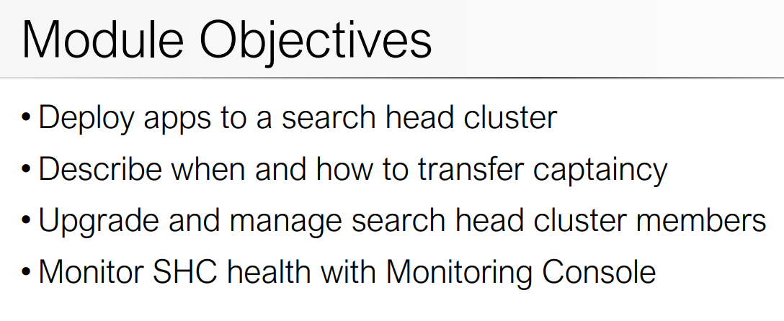

Slide 16
